Slide 1
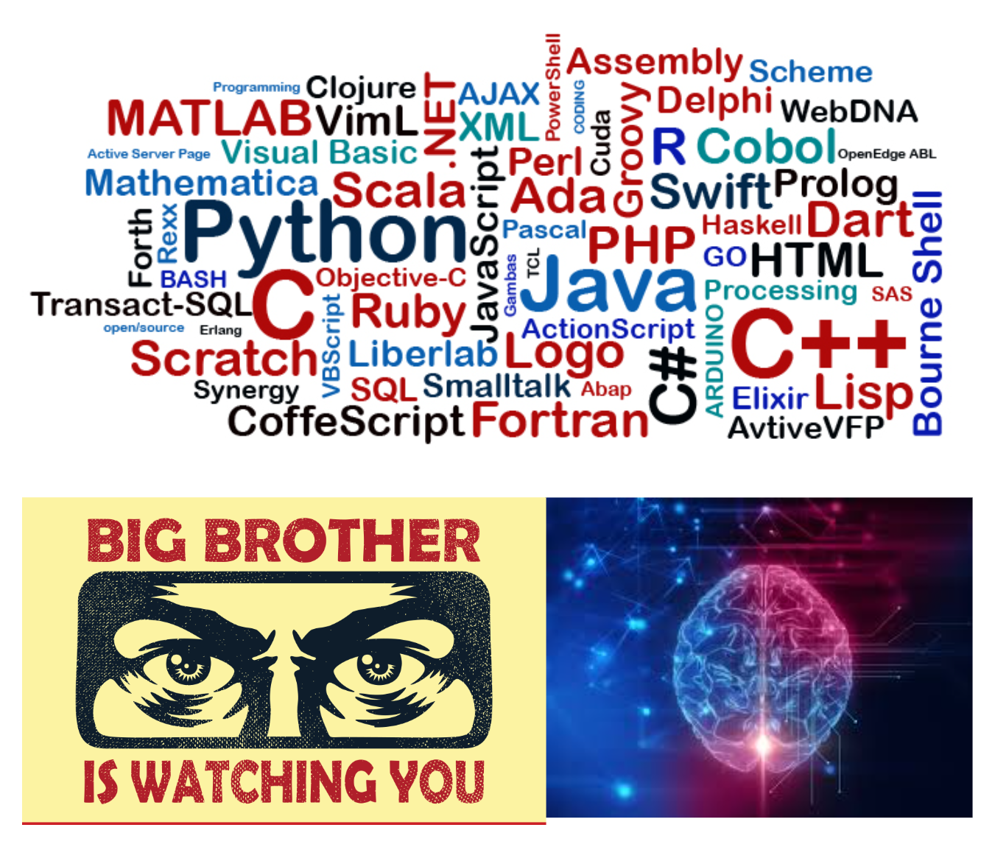
High-Level Programming Languages in AI Era
-In Terms of Human Thought and Mind-
Composed By: Hayato Ishida
For Japanese version, click here
Updated On: 30 June 2025

Slide 2

About Me
Accounts
GitHub: @hayat01sh1da
X: @hayat01sh1da
LinkedIn: @hayat01sh1da
Speaker Deck: @hayat01sh1da
Docswell: @hayat01sh1da
Occupation: Software Engineer
Things I Am Into
Linguistics
Singing at Karaoke
Listening to Music
Watching Movies
Cat Feeding

Slide 3
Licences / Certifications
English
TOEIC® Listening & Reading 915: Certified on December 2019
Engineering
Information Security Management: Certified on November 2017
Applied Information Technology Engineer: Certified on June 2017
Fundamental Information Technology Engineer: Certified on November 2016
IT Passport: Certified on April 2016
Others
Abacus 2nd Class: Certified on June 2002
Mental Arithmetic 3rd Class: Certified on February 2001

Slide 4
Skill Stack
Languages
Japanese: Native Proficiency
English: Full professional Proficiency
Development
Backend: Ruby(Ruby on Rails), Python
Frontend: TypeScript + React.js, TypeScript +Vue.js
Database: MySQL, PostgreSQL, MongoDB
Architecture: Monolith, Modular Monolith
Hosting: AWS ESK
Versioning: Git, GitHub
CI/CD: GitHub Actions, ArgoCD
Monitoring: Datadog, Sentry

Slide 5
Work Histories
Period | Genre | Position | Jobs
Aug 2021 - Present | Saas(Educational Service) | Software Engineer | Backend Development Frontend Development CI/CD Maintenance Weekly Release Manager Troubleshooting Documentation Technical Debt Resolution Tech Blog Entries LT Speaker
Feb 2020 - Dec 2020 | SaaS(Chatbot Platform) | Backend Engineer | Backend Development Documentation Technical Debt Resolution Inspection of Alternative API

Slide 6
Work Histories
Period | Genre | Position | Jobs
Jun 2018 - Jan 2020 | Contract-basis Developer | Software Engineer | Backend Development Frontend Development Troubleshooting Quality Assurance Tech Blog Entries
Apr 2016 - Jan 2018 | System Engineering Service | System Engineer | Corporate Account Admin Windows Server Maintenance Security Admin Assistant Internationalisation / Localisation

Slide 7
International-Exchange Activities
Activities in University
English Linguistics Seminar(Focusing on Mass Media English)
International-Exchange Clubs(The 2nd Year)
International-Exchange Programmes conducted by Japan Cabinet Office(2013 - 2016)
Japanese Linguistics Course(The Final Year)
Overseas Life Experience
Working Holiday in Australia(April 2014 - March 2015)
Language School for 1 month in Sydney
Work for 6 Months in Hamilton Island Resort
Volunteering for 1 Month as Assistant Teacher of Japanese Language at St Ives High School in NSW
Other Activities
Keep Everyday Journal in English (April 2014 - Present)
Sunrise Toastmasters Club(February 2017 - March 2018)
Vital Japan(January 2018 - July 2019, October 2022 - February 2023)
Self Learning and Training of English Language
Participation Ruby-Related Tech Conferences

Slide 8
Agenda
Let's Think about...
The Book I would Like to Introduce
High-Level Programming Languages in AI Era
Summary of The Worldview of The Book
Newspeak
Why Nineteen Eighty-Four?
References

Slide 9
1. Let's Think about...

Slide 10
1. Let's Think about...
Even given the reality that AI evolution is still in progress and high-level interface is still in need, the question is…
"What do we use high-level programming languages for in this highly advanced AI era?"

Slide 11
2. The Book I would Like to Introduce

Slide 12


2. The Book I would Like to Introduce
English Edition
Japanese Edition

Slide 13
3. High-Level Programming Languages in AI Era

Slide 14
3. High-Level Programming Languages in AI Era
Big Changes to Development Experiences brought by AI Tools
Rivalry of warlords in progress
GitHub Copilot
Devin
Clause Code
Cursor
More natural language on a prompt than programming language on IDE.
Trade-offs in terms of cost and time performance
Learning costs
Too speedy delivery by AI developers take pains at catching up with

Slide 15
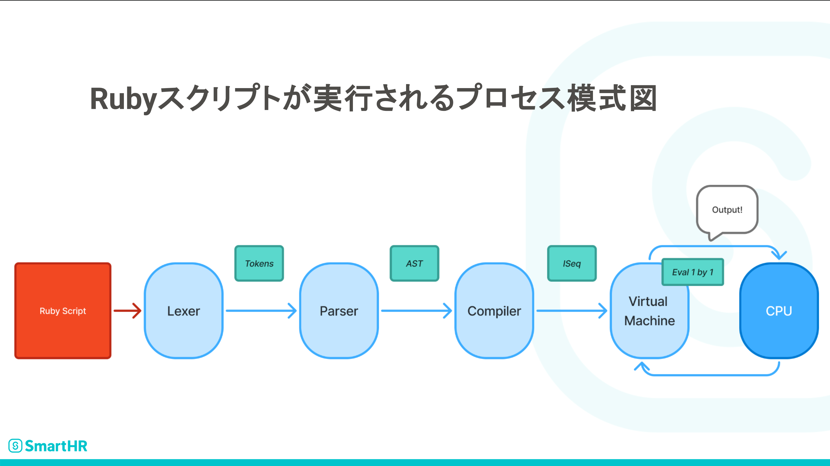
3. High-Level Programming Languages in AI Era
Were AI to directly generate expected bytecodes without any bugs, necessary ecosystem would be only Compiler and Virtual Machine in case of Ruby, for instance.
Necessary Ecosystem in coming 'Complete' AI Era
p.29, Uchio Kondo, Ruby の中身の予備知識 - RubyKaigi の前に知り鯛

Slide 16
3. High-Level Programming Languages in AI Era
What only human developers can but AI cannot in high-level programming language is…
Naming!!

Slide 17
4. Summary of The Worldview of The Book

Slide 18
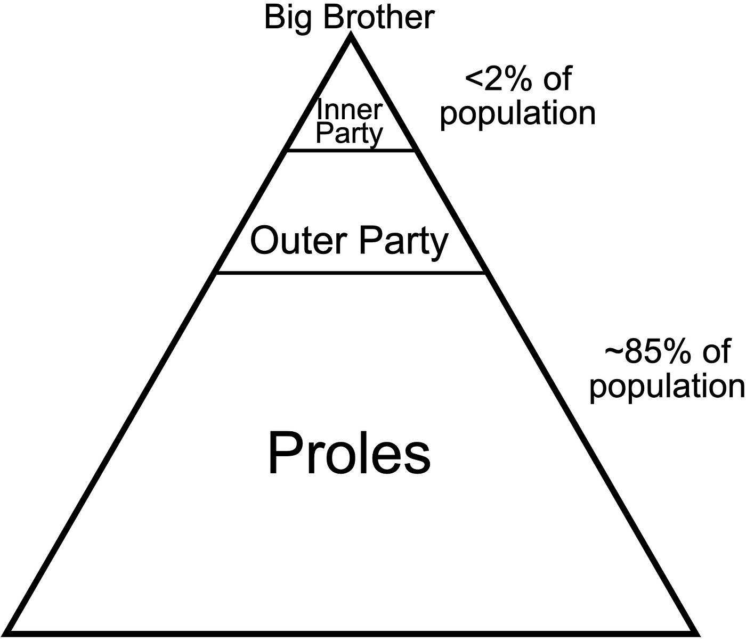
4. Summary of The Worldview of The Book
3 superstates: Oceania, Eurasia, Eastasia
Oceanic society: Everything was under control of its government
Hierarchy: Determined how much controlled the person is
Outer Party members: The very target of monitoring
Vocabulary: To control thoughts and minds of the Public
Thought / Mind: To control political ideologies of the public
Political Ideology: To realise INGSOC(English Socialism)
etc.
Proles: The majority but almost ignored
The public: Doomed to love Big Brother, who was the very symbol of INGSOC

Slide 19
4. Summary of The Worldview of The Book
To roughly compare it to an Anime…

Slide 20

4. Summary of The Worldview of The Book
The worldview of SPY × FAMILY might be close a bit.

Slide 21
5. Newspeak

Slide 22
5. Newspeak
Ecosystem: Another language from Oldspeak(the present-day or standard English as of 1984)
Commonization: Still in progress
In written context, only Times, one of news media, published leading articles in the language
Supersedure Plan: Expected to exterminate Oldspeak by 2050 in the end
Vocabulary: Reduced every year
Evolved in a totally opposite way from the present-day English we know today
The biggest aim: The narrower vocabulary, the fewer concepts thinkable
Side effects: Economy of Efforts and loss of awareness of the original concept
Categories: the A Vocabulary, the B Vocabulary and the C Vocabulary.

Slide 23
5. Newspeak
The A Vocabulary: Everyday Life Uses
Vocabulary: The number was extremely small and rigidly defined
No more derivatives: Among the etymologically connected words
thought(noun) / think(verb) → think(noun & verb)
knife(noun) / cut(verb) → knife(noun & verb)
Prefixes: Emphasised or denied the meaning of words
un- + good → ungood(≒ bad)
plus- + cold → pluscold(≒ very cold) > doubleplus- + cold → doublepluscold(≒ superlatively cold)
Suffixes: Formed adjectives or adverb
Adjective: speed + -ful → speedful(≒ rapid)
Adverb: speed + -wise → speedwise(≒ rapidly)

Slide 24
5. Newspeak
The A Vocabulary: Everyday Life Uses
Abbreviations: Made the meaning exactly opposite or ambiguous
joycamp(= forced-labour camp)
Minipax(= Ministry of Peace = Ministry of War)
Minitrue(= Ministry of Truth = Ministry manipulating historical records)
Miniluv(Ministry of Love = Ministry forcing rebels to love Big Brother by tortures)
Inflections: No more irregularities and analogy totally works
Verb: speak - spoke - spoken → speak - speaked - speaked
Adjective: good - better - best → good - gooder - goodest
ex. pronouns, relatives, demonstrative adjectives and axillary verbs

Slide 25
5. Newspeak
The B Vocabulary: Political Uses
Vocabulary: Consists of compounds
good + think → goodthink(≒ orthodoxy)
Verb: goodthink - goodthinked - goodthinked(≒ to think something in an orthodox way)
Adjective: goodthinkful(≒ orthodox)
Adverb: goodthinkwise(≒ orthodoxically)
Inflections: Closer to Oldspeak or Standard English than The Vocabulary A
Minitrue > Minitruthful: -trueful is awkward
Minipax > Minipeaceful: -paxful is awkward
Miniluv > Minilovely: -lovful is awkward

Slide 26
5. Newspeak
The B Vocabulary: Political Uses
Meaning of words: Required to master Newspeak to use and/or understand
In the following sentences, each corresponding part is highlighted in the same colour
Oldspeak: Those whose ideas were formed before the Revolution cannot have a full emotional understanding of the principle of English Socialism.
Newspeak: Oldthinkers unbellyfeel Ingsoc.
As you see, each word has too ambiguous meaning to understand at a glance
Word purging: Undesirable meanings in each word were exterminated
e.g. free means a status where something was removed as shown be free from ~. No more liberty nor something related to anti-governmental concepts
Duckspeak: The concept that an act was evaluated totally based on its behaviour

Slide 27
5. Newspeak
The C Vocabulary: Scientific and Technical Uses
Role: Supplementary element of The Vocabulary A and The Vocabulary B
Word purging: Undesirable meanings in each word were exterminated
Grammar: Same as The Vocabulary A and The Vocabulary B
Use case: Highly limited to science.
Irony: The term science itself was absent
The word Ingsoc covered it
The Vocabulary A
The Vocabulary B
The Vocabulary C

Slide 28
6. Why Nineteen Eighty-Four?

Slide 29
6. Why Nineteen Eighty-Four?
To cut a long story short, Nineteen Eighty-Four gives us a deep insight into…
Our developers' forever challenge in programming, naming!

Slide 30
6. Why Nineteen Eighty-Four?
We know naming is also a difficult work due to its trade-offs.
The longer the name is, the more redundant it is.
The short the name is, the more possible it fails to embody the important factors.
How should we name something in a concise and accurate way?
The answer is word forming of The A Vocabulary, The B Vocabulary and The C Vocabulary in the previous chapter.

Slide 31
6. Why Nineteen Eighty-Four?
The words below emerged on social media and have got citizenship as you know.
They represent addition of prefix un- to existing words in The A Vocabulary.
friend ↔ unfriend
like ↔ unlike
star ↔ unstar
flag ↔ unflag
follow ↔ unfollow

Slide 32
6. Why Nineteen Eighty-Four?
Naming should be the last thing AI is good at the first thing only we human developers must pay attention to.
The creator of Ruby Mr. Yukihiro Matsumoto, generally called Matz, is known as a strict developer on naming, according to a popular book 107. The Importance of Naming on Japanese Edition of 97 Things Every Programmer Should Know.
That is because he believes naming reflects the system architecture.
Only human developers can take it into account in naming of a class, module, method and so on, as of today.
* For the details of an interesting episode, refer to Road to Ruby for A Linguistics Nerd > 3. The Most Memorable Discussion Mr. Matz.

Slide 33
6. Why Nineteen Eighty-Four?
Here is the very reason we developers use high-level programming languages in this highly advanced AI era.
What is it?
It is because they are the only means by which we can express how we design, recognise and implement the architecture.
Most codes are written and read by human developers today, so they must be as 'self-evident' as possible by appropriate naming at a glance.
You will learn universal linguistic principles helpful for naming from Newspeak!

Slide 34
6. Why Nineteen Eighty-Four?
George Orwell, the author of Nineteen Eight-Four, is highly likely to have predicted the following present-day affairs as we see today while he was writing it.
New types of word formation on social media
Political correctness and censorship
Ongoing dictatorship and wars among some countries
etc.
You will learn something universal from Nineteen Eighty-Four, so it is high time to read it!

Slide 35
6. Why Nineteen Eighty-Four?
There is no reason not to read Nineteen Eighty-Four!
Share your reviews and exchange opinion with me!!
I am excited for it!!!

Slide 36
7. References

Slide 37
7. References
Michael L. Geis, Language and Communication, Oxford, OUP, 2001
George Orwell, Nineteen Eighty-Four, the United Kingdom, Harvill Secker, 1949
Uchio Kondo, Ruby の中身の予備知識 - RubyKaigi の前に知り鯛, Tokyo, SmartHR, 2025
Villains Wiki
Last Accessed At: 28 June 2025
Moore Spring, Analogy, University of California San Diego, California, 2013
プログラマが知るべき97のこと
Last Accessed On: 05 May 2025
Hayato Ishida, Dive Deeper into Present-Day English Vol.3 -English Vocabulary 1(Compounds・Derivatives・Load Words)-, Tokyo, Hayato Ishida, 2021
Hayato Ishida, Road to Ruby for A Linguistics Nerd, Tokyo, Hayato Ishida, 2025

Slide 38
EOD

